Slide 1
Methods for Short Term Projections in epidemics (Projections Package)
Pierre Nouvellet, Anne Cori,Thibaut Jombart, Sangeeta Bhatia
pierre.nouvellet@sussex.ac.uk

Slide 2
Structure
Context
Basic principle: from model to inference to predictions?
Caveats
Notes:
communication obstacles that originated from researchers immersed in the traditions of particular disciplines

Slide 3
Structure
What do I mean by projections/forecasts/predictions?
Projections: short term not mechanistic – taking current trend and continuing
Forecasts: relies on somehow more mechanistic model but typically assumes conditions in future remain stable
Predictions: relies on understanding the system and making hypothesis about future conditions – closer scenario modelling
Notes:
communication obstacles that originated from researchers immersed in the traditions of particular disciplines

Slide 4
Projection/Forecasting
Importance, especially in context of public agencies and stakeholders:
Advocacy and planning
Monitoring the situation
Implementation/evaluation of control strategies
Challenges:
Uncertainties surrounding the data
Uncertainties surrounding the dynamics of transmission
In such context, we initially focussed on projecting case incidence:
Pro: Robust methodology
Con: weak mechanistic underlying model, so limited use for modelling the impact of interventions

Slide 5

The reproduction number
Basic reproduction number R₀: average number of secondary cases generated by an index case in a large entirely susceptible population
Y=1
t=1
Y=2
t=2
Y=4
t=3
Y=8
t=4
Contagion
Incidence
R_{t} = 5
Effective reproduction number R_{t}
→ equivalent at time t
R_{t} =2
SI = 2.1
Time
SI = 4

Slide 6
Methods
Estimation of R0 and Rt:
As long as there is a large proportion of susceptibles in the population, the epidemic will grow exponentially R0 (later we define Rt)
Incidence
R_{t} = 5
R_{t} =2
SI = 2.1
Time
SI = 4
The serial interval (time between symptoms onset of infector and symptoms onset of infectee), informs on the value of R_{t}

Slide 7
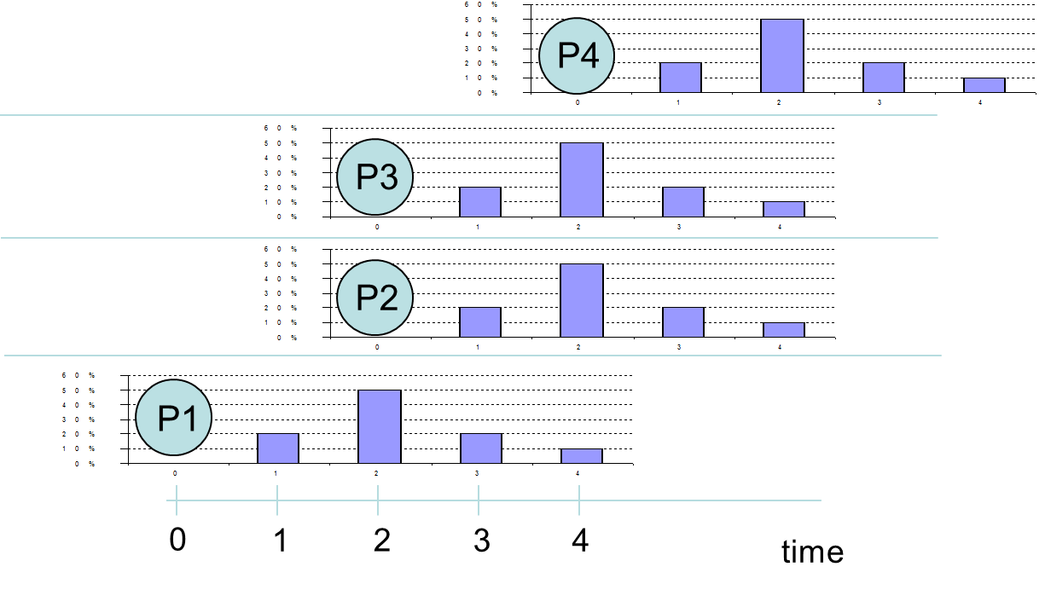
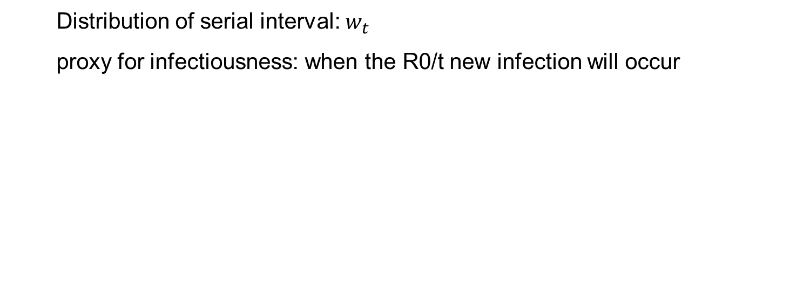
Methods
Distribution of serial interval: $w_{t}$
proxy for infectiousness: when the R0/t new infection will occur

Slide 8
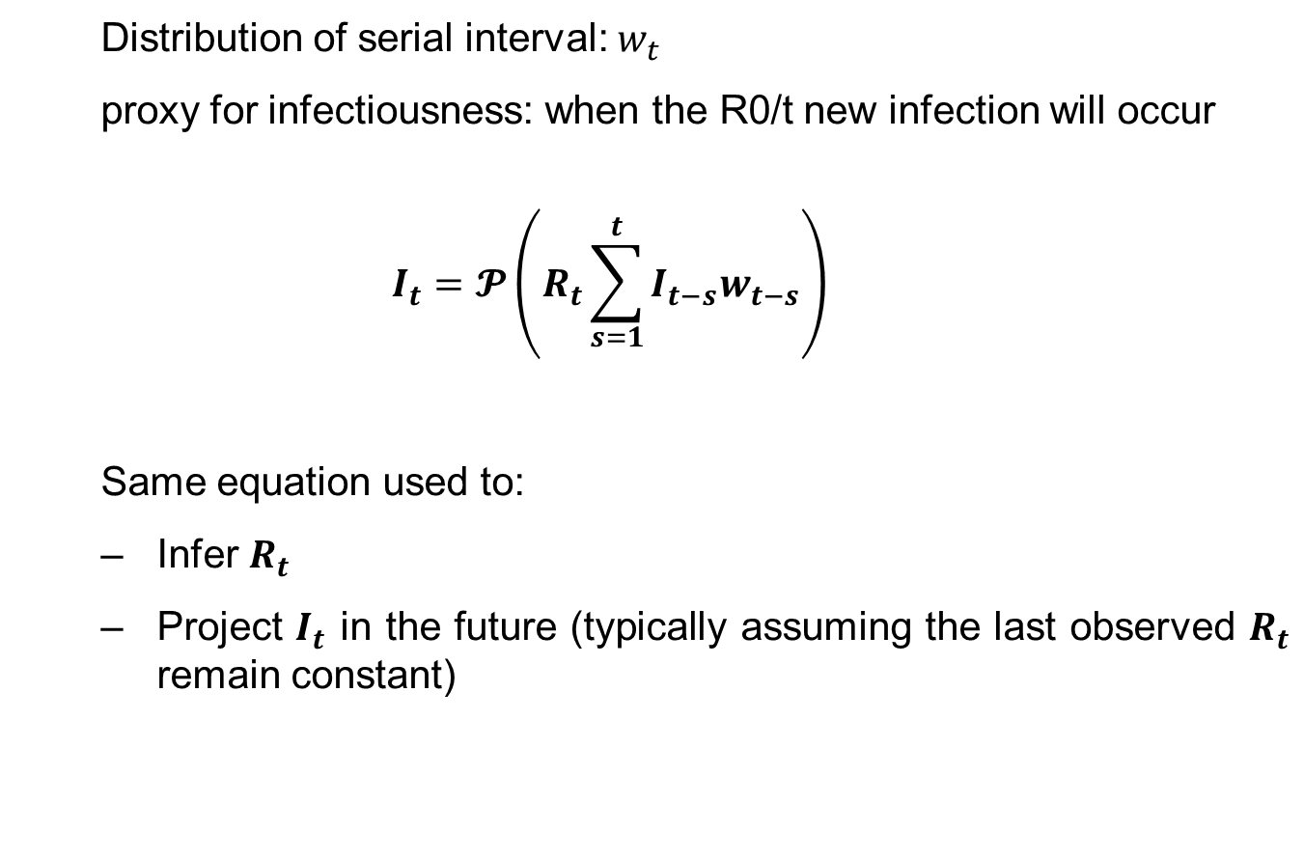
Methods
Distribution of serial interval: $w_{t}$
proxy for infectiousness: when the R0/t new infection will occur
$$I_{t}=𝓟\left(R_{t}\sum_{s=1}^{t}{I_{t−s}w_{t−s}}\right)$$
Same equation used to:
Infer $R_{t}$
Project $I_{t}$ in the future (typically assuming the last observed $R_{t}$ remain constant)

Slide 9
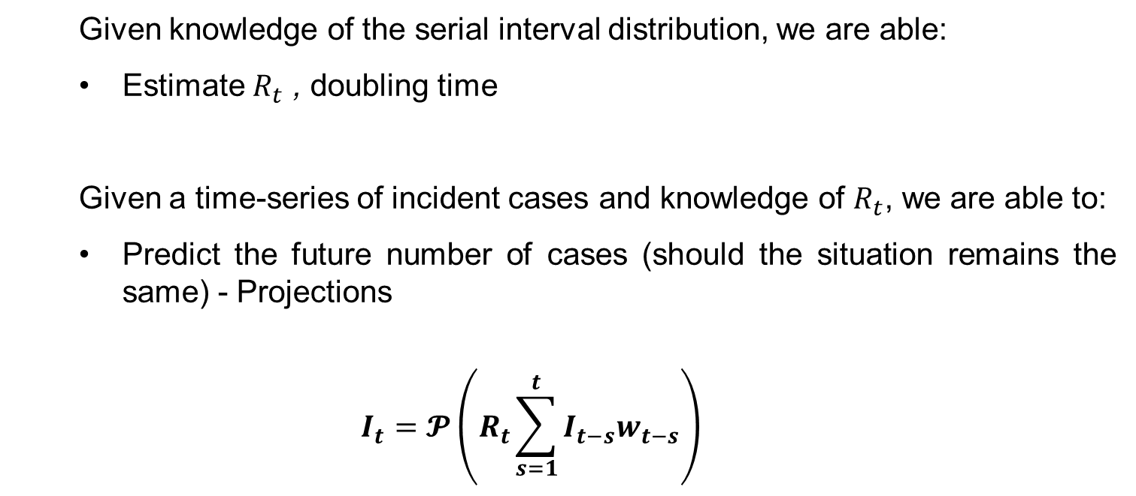
Methods
Given knowledge of the serial interval distribution, we are able:
Estimate $R_{t}$ , doubling time
Given a time-series of incident cases and knowledge of $R_{t}$, we are able to:
Predict the future number of cases (should the situation remains the same) - Projections
$$I_{t}=𝓟\left(R_{t}\sum_{s=1}^{t}{I_{t−s}w_{t−s}}\right)$$

Slide 10
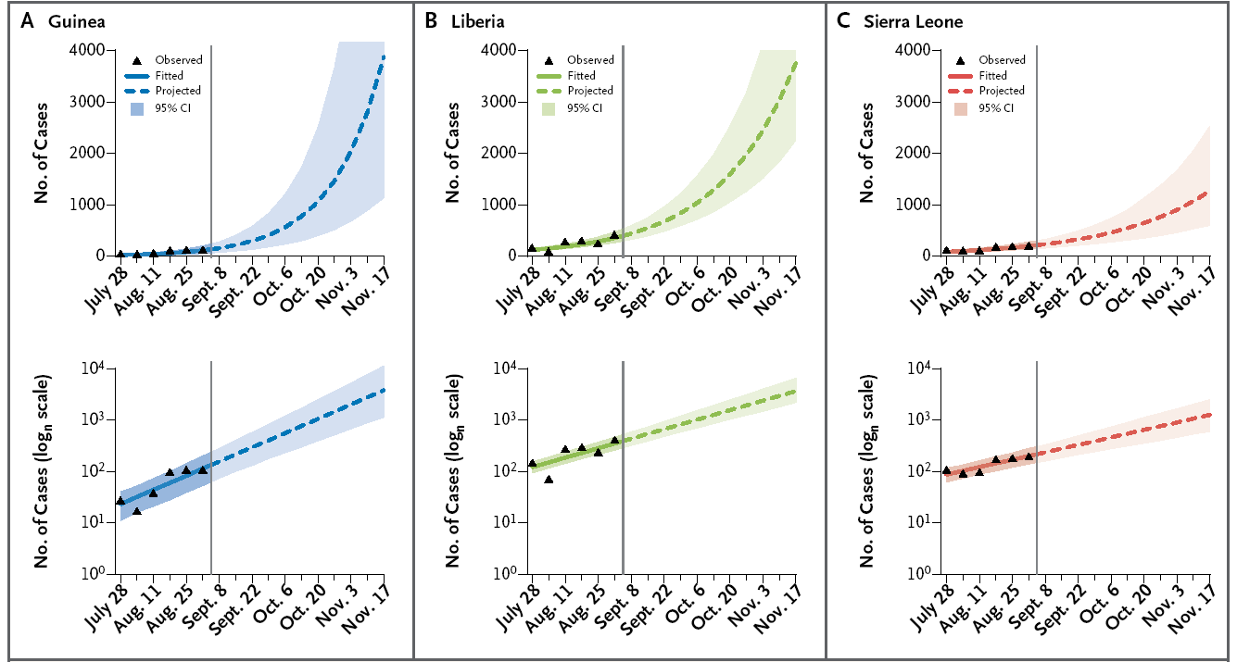
How quickly was the virus spreading? September 2014
 | Guinea | Liberia | Sierra Leone
R_{t} | 1.81 (1.60–2.03) | 1.51 (1.41–1.60) | 1.38 (1.27–1.51)
Initial doubling time (days) | 15.7 (12.9–20.3) | 23.6 (20.2–28.2) | 30.2 (23.6–42.3)
Important for advocacy, planning
[WHO Ebola Response Team. 2014, NEJM]

Slide 11
How quickly was the virus spreading? March 2015

Slide 12
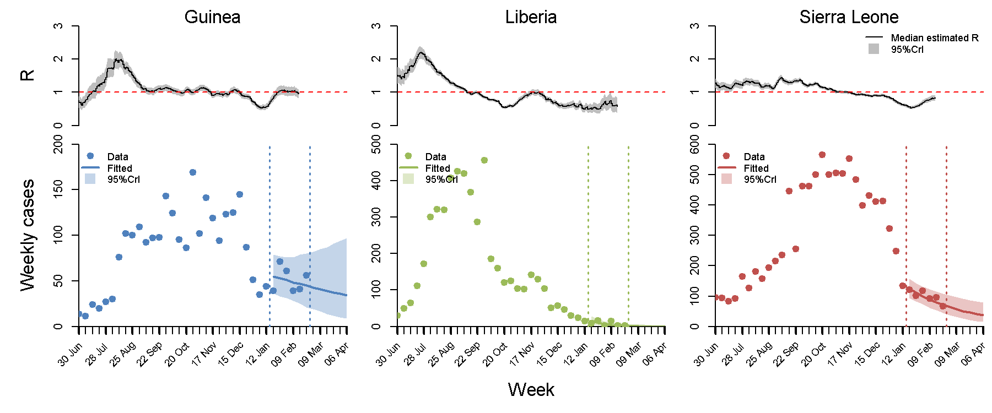
How quickly was the virus spreading? March 2015

Slide 13
How quickly was the virus spreading? March 2015
 | Guinea | Liberia | Sierra-Leone
 | 0.93 (0.77 ; 1.09) | 0.43 (0.26 ; 0.68) | 0.82 (0.74 ; 0.91)
Time to extinction | > 1 year (2015-07-16, > 1 year) | 2015-03-22 (2015-02-18, 2015-06-12) | 2015-11-22 (2015-07-13, > 1 year)

Slide 14
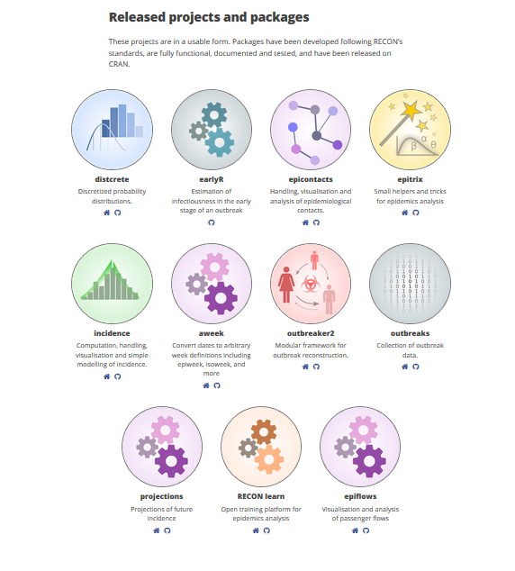

Implementation
Implemented in a R package available in Recon website (projection

Slide 15
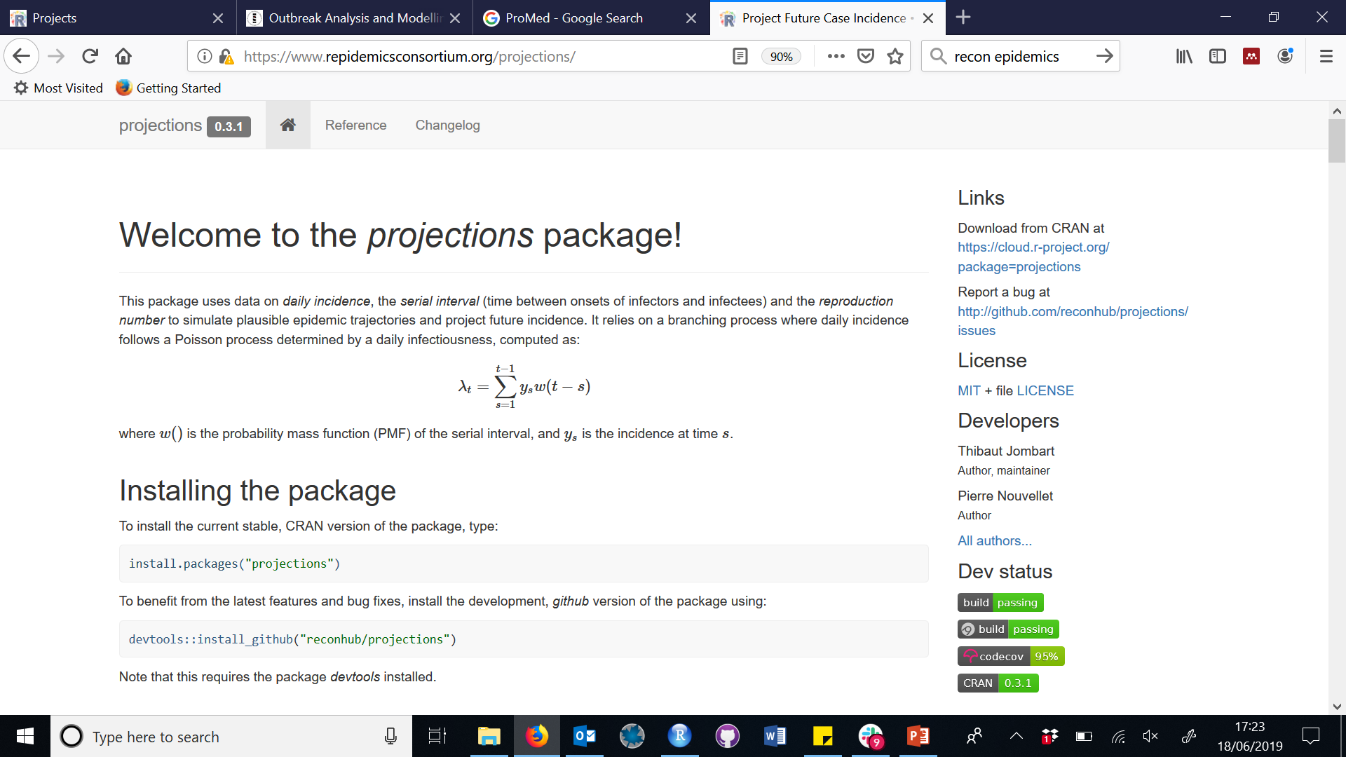
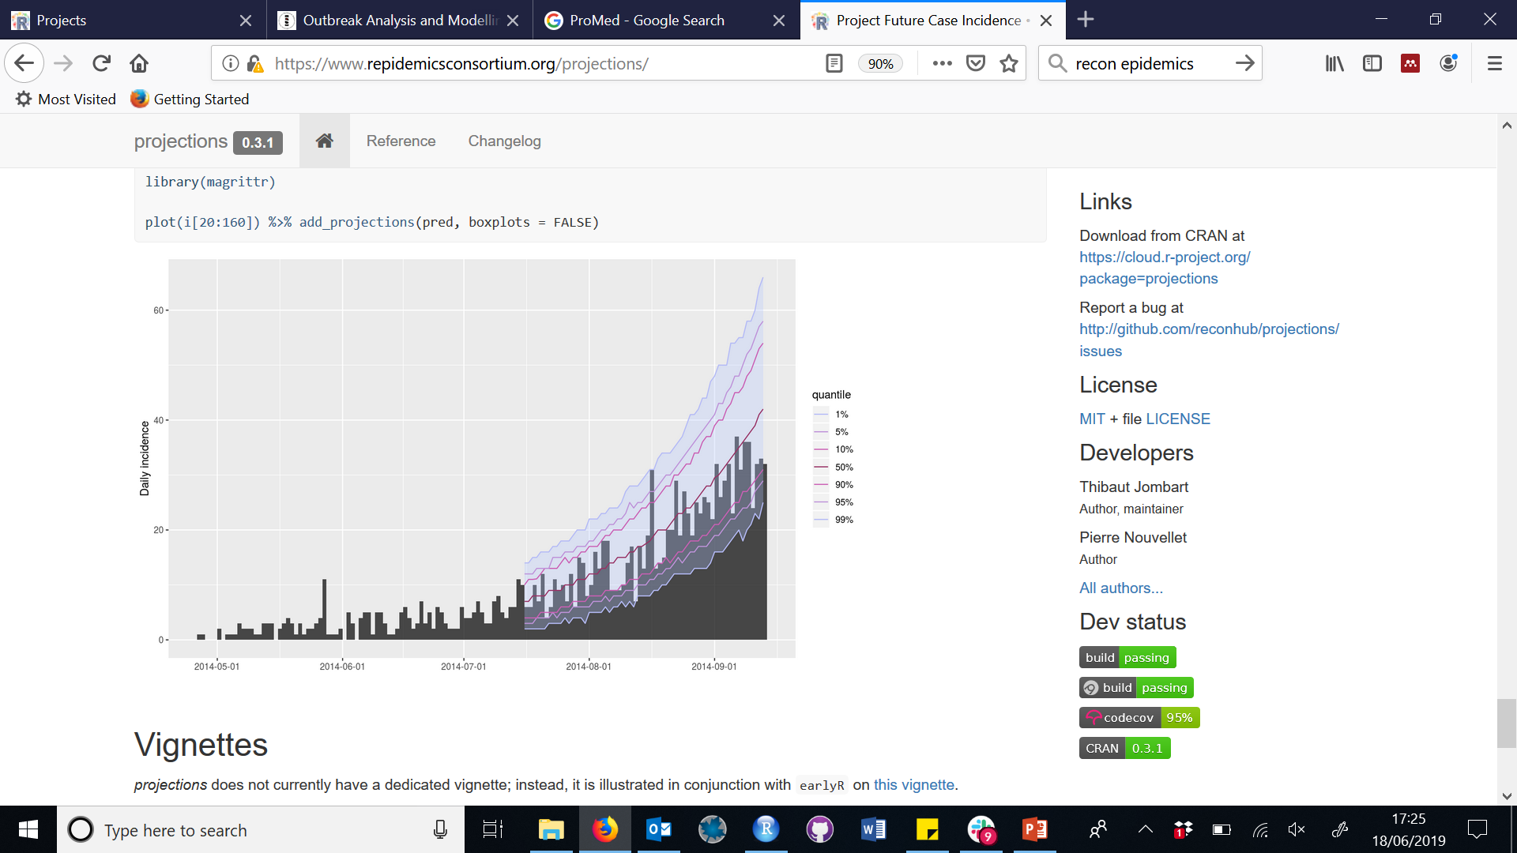
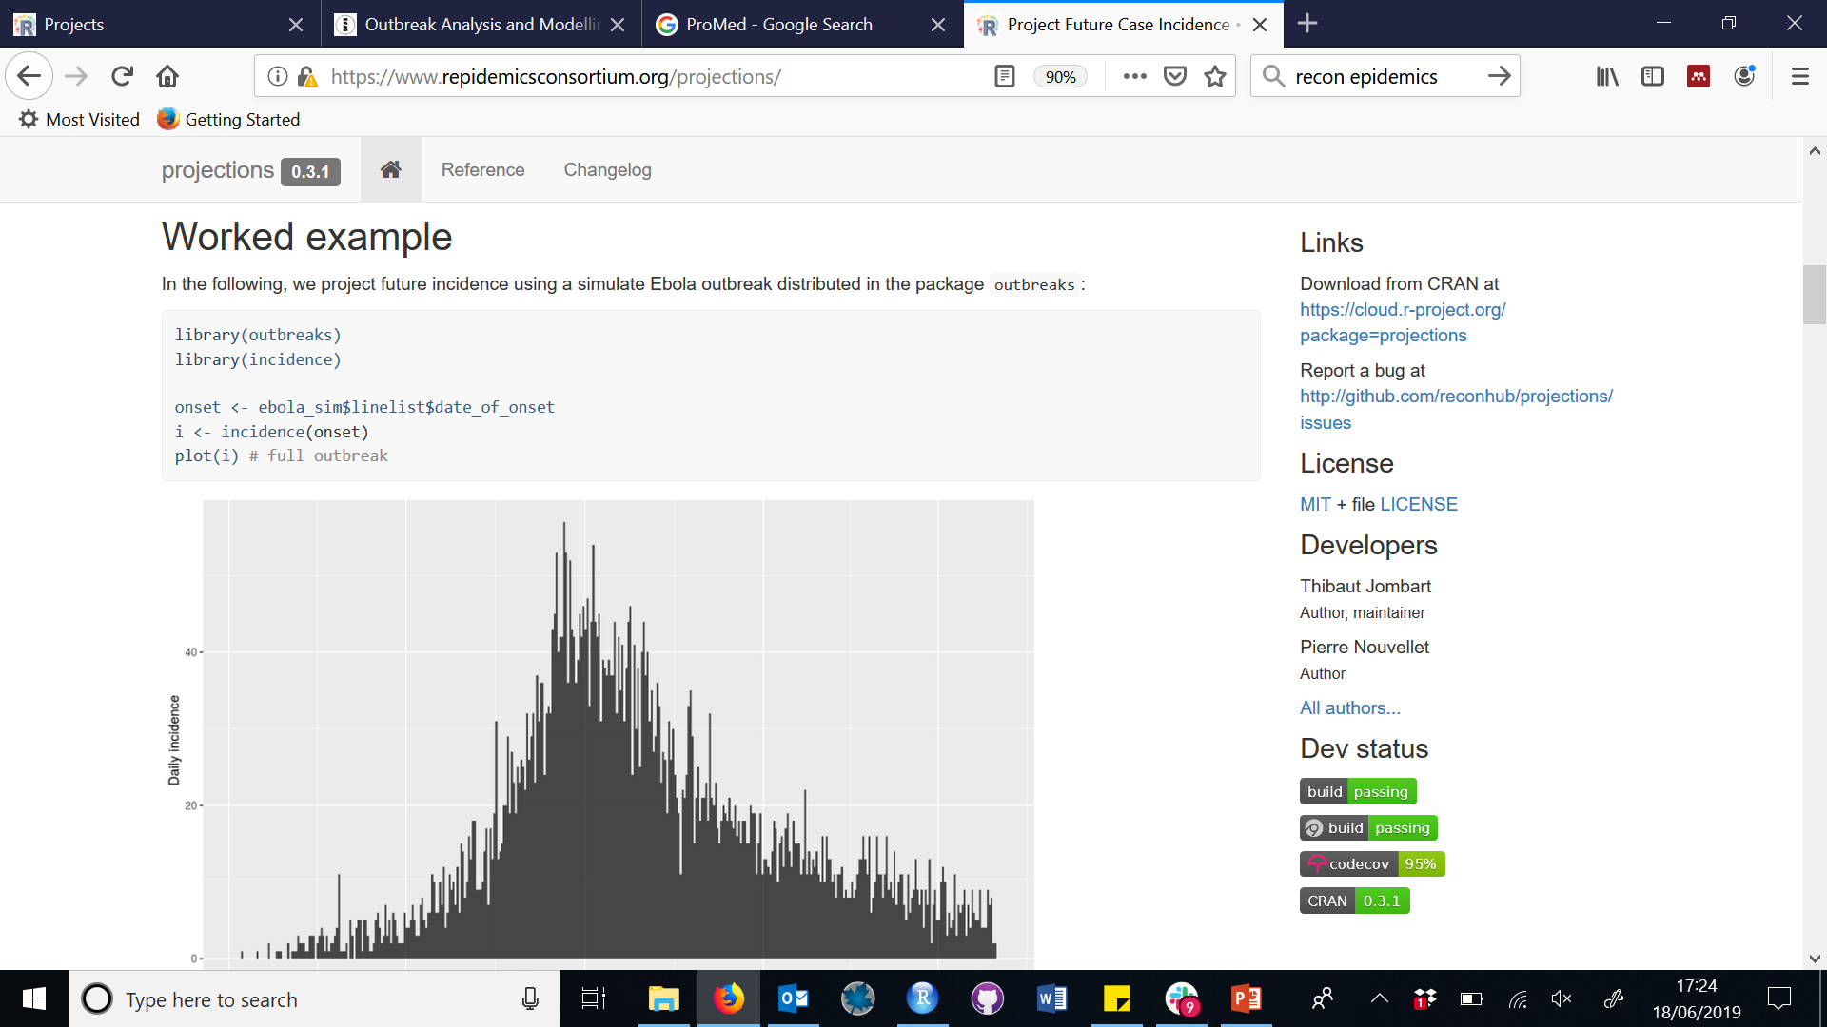
Implementation
Implemented in a R package available in Recon website

Slide 16
From projections to forecasting?
Can we say more about the determinants of Ebola dynamics?
Exposure patterns driving Ebola transmission in West Africa
International Ebola Response Team (2016), PLoS Medicine

Slide 17
From projections to forecasting?
Can we say more about the determinants of Ebola dynamics?
Reproduction number for a given month was correlated with:
% of individuals reporting funeral exposure (positive correlation)

Slide 18
From projections to forecasting?
Can we say more about the determinants of Ebola dynamics?
Reproduction number for a given month was correlated with:
% of individuals reporting funeral exposure (positive correlation)
% of individuals hospitalised within 4 days (negative correlation)

Slide 19
From projections to predictions?
Can we make predictions if conditions were different?

Slide 20
From projections to predictions?
Key
(a) PCR -Only
PCR
RDT
RDT
In HU
Uninfected
Infected (and infectious)
Newly infected

Slide 21
From projections to predictions?
Key
(a) PCR -Only
PCR
RDT
RDT
In HU
Uninfected
Infected (and infectious)
(c) RDT-Only
RDT used to sort patients.
Newly infected

Slide 22
From projections to predictions?
Key
(a) PCR -Only
PCR
RDT
Low risk
High risk
RDT
In HU
(b) Dual Strategy
RDT used to sort patients.
Uninfected
Infected (and infectious)
(c) RDT-Only
RDT used to sort patients.
Newly infected

Slide 23
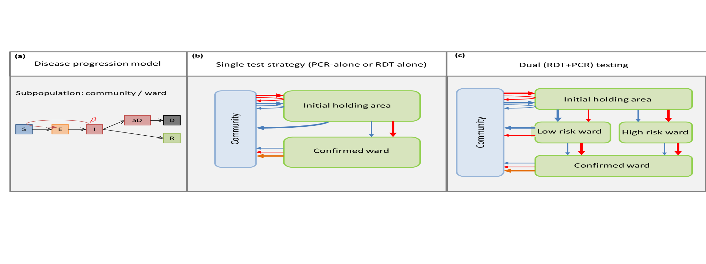
From projections to predictions?

Slide 24
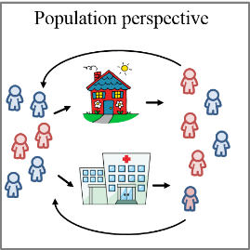
From projections to predictions?

Slide 25
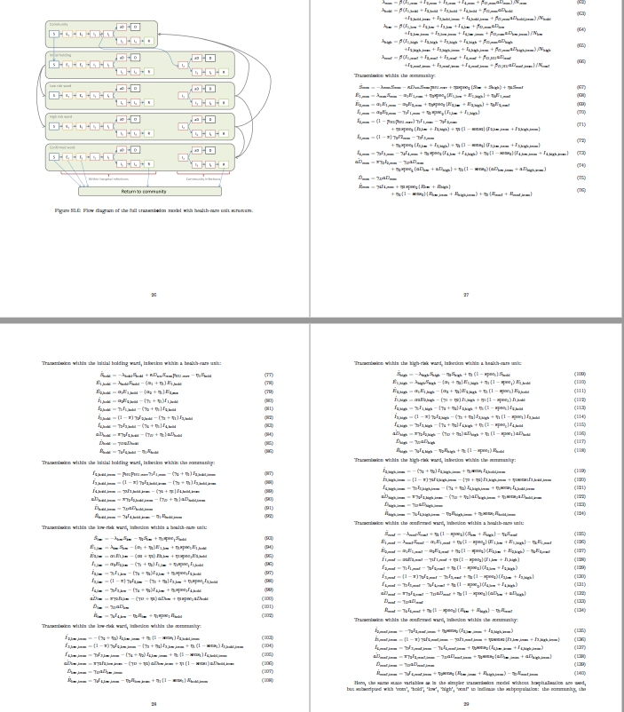
From projections to predictions?
But requires even better understanding of the dynamics:
Easy to construct,
Hard to parameterise,
Can be hard to interpret results.

Slide 26
Caveats for projections
When using projections, things to consider:
Caveats linked to estimation of transmissibility (e.g. epiestim issues if level reporting changes or delay in reporting)
Assume constant transmissibility in the future – to be used for short term projections (few serial intervals)
Be aware of the importance of accounting for
Delay in reporting
Uncertainty in current situation before projecting in the future (nowcasting)
Heterogeneity in transmission
Notes:
communication obstacles that originated from researchers immersed in the traditions of particular disciplines

Slide 27
Caveats for projections
Heterogeneity in transmission
Notes:
communication obstacles that originated from researchers immersed in the traditions of particular disciplines

Slide 28
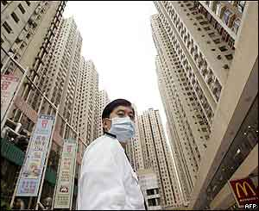
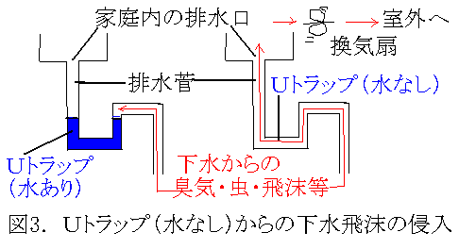
SARS and heterogeneity in transmission
The cases of Amoy garden:
over 300 cases
Concentrated in 4 blocks
Required quarantine
Linked to drainage system

Slide 29
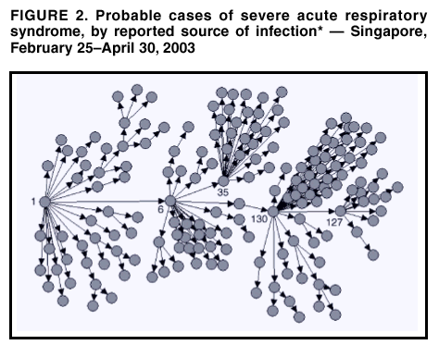
SARS and heterogeneity in transmission
SARS and heterogeneity in transmission
Reproduction number:
The number of cases one case generates on average over the course of its infectious period
Contagion
Typically require detailed investigation

Slide 30
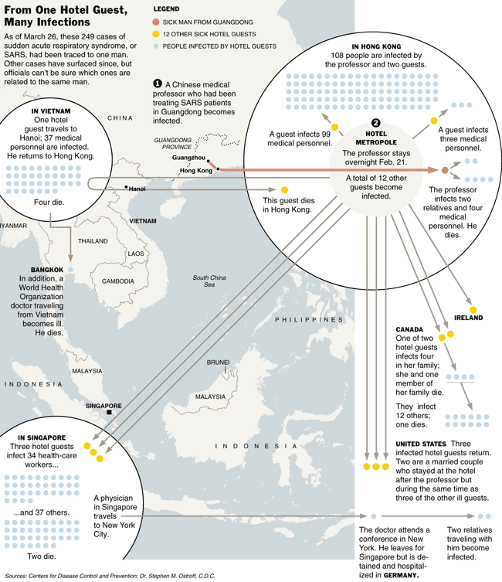
SARS and heterogeneity in transmission
SARS and heterogeneity in transmission
Reproduction number:
The number of cases one case generates on average over the course of its infectious period,
BUT…

Slide 31
SARS and heterogeneity in transmission
Simplest case, assumes:
Number of secondary cases for each infectious individual follows a Poisson distribution (offspring distribution)
Same mean for everyone (R)
Increased heterogeneity, assumes:
Individual ‘offspring distribution’ is still Poisson
Individual R is gamma distributed (not the same for everyone)
Negative binomial offspring distribution for the population

Slide 32
SARS and heterogeneity in transmission
Simplest case, assumes:
Number of secondary cases for each infectious individual follows a Poisson distribution (offspring distribution)
Same mean for everyone (R)
Increased heterogeneity, assumes:
Individual ‘offspring distribution’ is still Poisson
Individual R is gamma distributed (not the same for everyone)
Negative binomial offspring distribution for the population

Slide 33
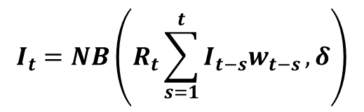
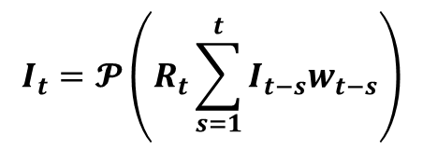
SARS and heterogeneity in transmission
Simplest case, assumes:
Number of secondary cases for each infectious individual follows a Poisson distribution (offspring distribution)
Same mean for everyone (R)
Implications for Projections
$$I_{t}=𝓟\left(R_{t}\sum_{s=1}^{t}{I_{t−s}w_{t−s}}\right)$$
Increased heterogeneity, assumes:
Individual ‘offspring distribution’ is still Poisson
Individual R is gamma distributed (not the same for everyone)
Negative binomial offspring distribution for the population
$$I_{t}=NB\left(R_{t}\sum_{s=1}^{t}{I_{t−s}w_{t−s}}, δ\right)$$

Slide 34
SARS and heterogeneity in transmission
Simplest case, assumes:
Number of secondary cases for each infectious individual follows a Poisson distribution (offspring distribution)
Same mean for everyone (R)
Implications for
outbreak extinctions
Increased heterogeneity, assumes:
Individual ‘offspring distribution’ is still Poisson
Individual R is gamma distributed (not the same for everyone)
Negative binomial offspring distribution for the population
=Poisson

Slide 35
Thank you!

